Slide 1
Intro to Java
An Oversimplification

Slide 2
Syntax in java
Single-line statements end with a semicolon (;)
Multi-line statements may have code blocks
Code blocks are denoted with {curly braces}

Slide 3
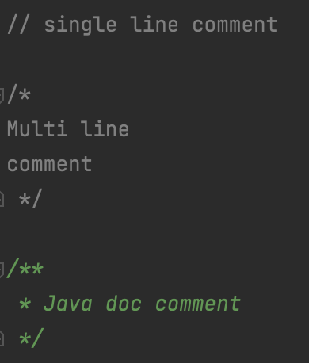
Comments in java
Comments tell others how your program works
Comments are just skipped over when running your program
Will not influence the execution of your program at all
Have single line comments, multi line comments, and Javadoc comments
Single line comments: //
Multi line comments: /* */
Javadoc: /** */
Used for documentation, can be exported to a website
Comments will be used in this to annotate programs and explain concepts

Slide 4
Packages
Like folders
Goes from broad to narrow
Used to organize programs
To reference a package, put a dot between each part
Normally a backwards domain name (or non-existent domain name)
Package declaration is placed at the top of every file
Example: com.calebli.tutorial

Slide 5
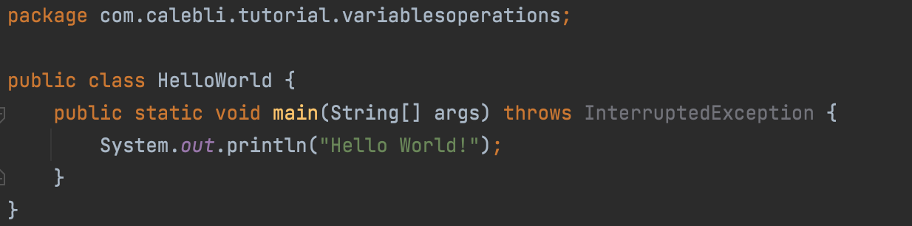
Making your first program
Create a class
Create main method
Always needs to be public static void main(String[] args)
Java runs the main method, so your code should go there
System.out.println(“Hello World!”)

Slide 6
What happened?
Java ran the main method inside your class
The main method contained a println statement that printed “Hello World” to the console

Slide 7


System.out.println()
Used for outputting to the console
Print data to the user
Println goes to the next line after printing
Print doesn’t go to the next line, so the next print will happen on the same line
Println goes to the next line
Print doesn’t go to the next line

Slide 8
Variables and operations

Slide 9
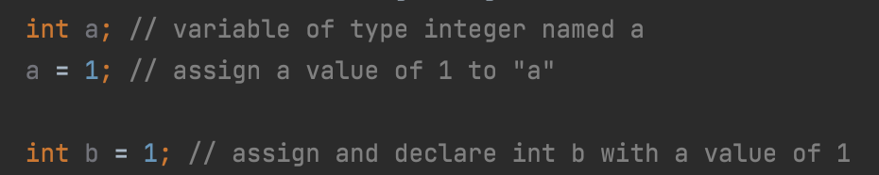
Variables
Stores data of different types
Data can be recalled by using the variable name
Declare a variable with the type and the name
Save a space for a variable of type ___ and give it the name ___
Give variables values with the assignment operator (=)
Able to declare and assign in one step

Slide 10
Primitive Data types
boolean – most basic data type, stores true or false
int (integer) – stores a whole number from -2.15 billion to 2.15 billion
float – stores a floating point number (i.e. decimal point “floats” around); IEEE 32 bit float
double – stores a floating point number double the capacity/precision of a float; IEEE 64 bit float
byte – stores a whole number from -128 to 128
short – store a whole number from -32,768 to 32,767
long – stores a whole number from -2⁶³ to -2⁶³-1
char – stores a Unicode character surrounded by ‘single quotes'
Unicode is a standard for making emojis, symbols, and characters from many different languages

Slide 11
Using data types
Use boolean for things that only need 2 values
For example, a light switch can be on or off, true or false
Use int for numbers without decimals
For example, counting the number of cars, there can’t be a half car
Use long if you need really big numbers and int is too small
Use double for numbers with decimals
For example, the circumference of a circle

Slide 12
Assigning values
Floats need to be suffixed with an “F” or “f”
Otherwise, Java will think it’s a double
Longs need to be suffixed with an “L” or “l”
Otherwise, Java will think it’s an int
Should not use “l”, might think it is a 1 (one)
Bytes and shorts don’t need to be suffixed with anything
YOU MUST DECLARE VARIABLES BEFORE ASSIGNING THEM

Slide 13
Typecasting
Typecasting converts between types
Widening = convert to a type that can store more data
Narrowing = convert to a type that can store less data
Decimals will be truncated when converting from a floating point number to an integer number
Example: converting an int to a double is widening
Java widens automatically as necessary
You can narrow by putting the new type in parentheses
int myInt = (int) 10.3;
byte, short, char, int, long, float, double

Slide 14
Variables and data types game
Assignment, declaration, and primitive data types

Slide 15
Strings
Store text data
Not a primitive data type, but can be used as one
Created by surrounding text in “double quotes”
Can be combined by “adding” two strings together
“hello “ + “world” = “hello world”

Slide 16
Numeric Operators
Operation | Symbol | Example
Addition | + | 5 + 6 = 11
Subtraction | - | 10 - 8 = 2
Multiplication | * | 9 * 3 = 27
Division | / | 4 / 2 = 2
Modulus | % | 7 % 2 = 1
Addition (+)
Subtraction (-)
Multiplication (*)
Division (/)
Modulus (%)
Remainder
Java follows order of operations
Parentheses, multiplication, division, modulus, addition, subtraction

Slide 17
Other numeric operations
Other operations can be found in the Math class
Example: Math.sin(x) outputs the sine of x
All of the trig functions are in radians
To convert to radians, use Math.toRadians()
Absolute value is Math.abs()
Exponents are Math.pow(base, exponent)
Floor and ceil take the input and either round them down (floor) or up (ceil)
Round does normal rounding
Max and min finds the maximum and minimum of two inputs

Slide 18
Integer vs floating point division
If both operands are integers, the decimals are truncated
Example: 5/3 = 1
Both numbers are integers so the decimal part goes away
If at least ONE of the operands is a floating point (float or double), the decimals are NOT truncatetd
Example 5.0/3 = 1.66666667
One number has a decimal so the decimal part stays

Slide 19

Augmented assignment operators
Just like numeric operators but takes value from variable, does operation, and stores result back in variable
Multiply x by 2 to get 6
Store 6 into x

Slide 20
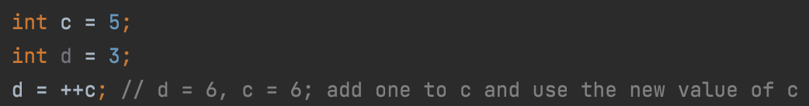
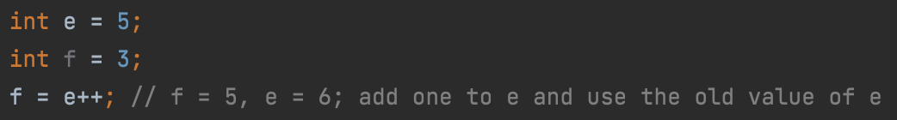
Increment and decrement operators
Add or subtract 1 from the variable
++x, x++, --x, x--
Can be used in expressions or standalone
Pre-increment increments and uses the new value
Post-increment uses the old value then increments
Pre/post doesn’t matter if not using in an expression

Slide 21
Increment and decrement operators cont’d
Name | Symbol | Definition | Example (x = 1)
Pre-increment | ++x | Adds 1 to x and uses the new value | y = ++x y is now 2
Post-increment | x++ | Adds 1 to x and uses the old value | y = x++ y is now 1
Pre-decrement | --x | Subtracts 1 from x and uses the new value | y = --x y is now 0
Post-decrement | x-- | Subtracts 1 from x and uses the old value | y = x-- y is now 1

Slide 22
Boolean operations
AND operator – outputs true if both inputs are true
OR operator – outputs true if either input is true
NOT operator – outputs the opposite of the input
Order of operations
NOT
AND
OR

Slide 23
Truth tables
AND Truth Table
OR Truth Table
A | B | A && B
true | true | true
true | false | false
false | true | false
false | false | false
A | B | A || B
true | true | true
true | false | true
false | true | true
false | false | false
Not Truth Table
A | !A
true | false
false | true

Slide 24
Comparison operators
Operator | Definition | Example
== | Equals | 1 == 1 is true
!= | Not equal | 3 != 2 is true
>= | Greater than or equal to | 2 >= 5 is false
<= | Less than or equal to | 5 <= 5 is true
> | Greater than | 8 > 9 is false
< | Less than | 7 < 5 is false

Slide 25
Java operators game
Numeric, Boolean, and comparison operators

Slide 26
Case study: Averaging numbers
A program that finds the average of 3 numbers

